Slide 1
Fraudulent Claim Detection

Slide 2
The Problem
Global Insure, a leading insurance company, processes thousands of claims annually. However, a significant percentage of these claims turn out to be fraudulent, resulting in considerable financial losses.Global Insure wants to improve its fraud detection process using data-driven insights to classify claims as fraudulent or legitimate early in the approval process. This would minimise financial losses and optimise the overall claims handling process.

Slide 3
Business Objective
Global Insure wants to build a model to classify insurance claims as either fraudulent or legitimate based on historical claim details and customer profiles. By using features like claim amounts, customer profiles and claim types, the company aims to predict which claims are likely to be fraudulent before they are approved.

Slide 4
Methodology
Data Preparation and Cleaning
i). The dataset consists of 40 columns and 1000 rows.
ii). Missing values were handled via imputation strategies such as mode replacement for categorical features and specific treatments for missing values in property_damage and police_report_available columns.
iii). Redundant columns were dropped based on uniqueness analysis (e.g., policy_number and _c39).

Slide 5
Submitted By:
Rajiv Ranjan
Rohit Pandey

Slide 6
Process taken care :
Data cleansing.
EDA
Data Analysis
Modeling
Prediction
Model selection

Slide 7
Data Cleaning
Removed few unnecessary columns data:
collision_type
authorities_contacted
property_damage
police_report_available

Slide 8
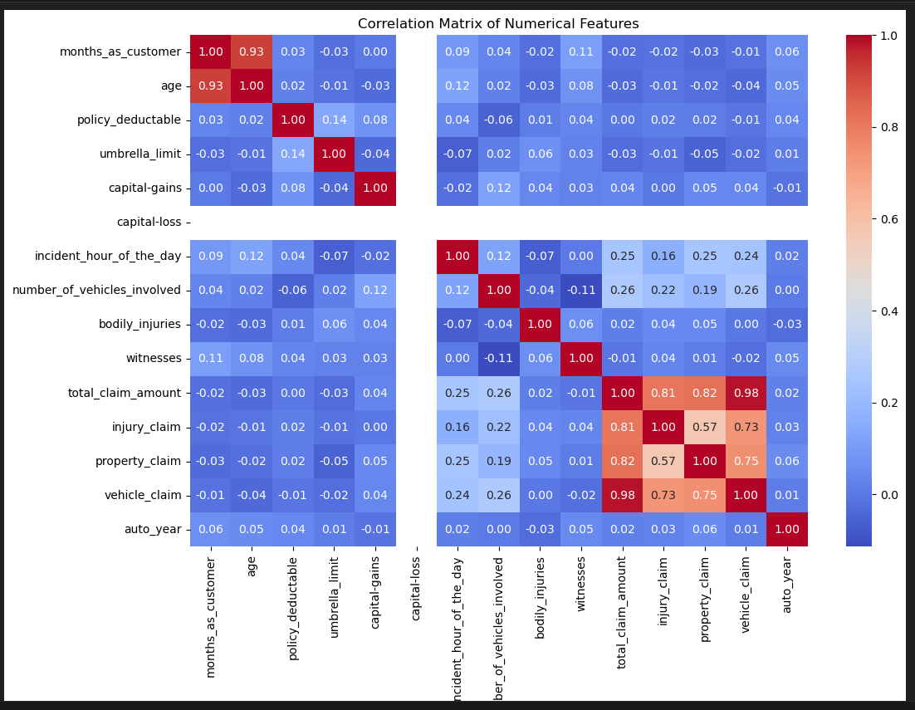
EDA
Correlation analysis

Slide 9
EDA
Plot all the numerical columns to understand their distribution

Slide 10
Conclusion
Fraud Detection & Risk Indicators:
Policyholders with multiple open claims and high deductible policies could indicate potential fraud risk.
Claims involving higher than usual vehicle repairs, property damage, or injury compensation often contain outliers and should be further investigated.
Common Customer Characteristics:
Most customers are around 40 years old, hold policies for 100 months, and have standard deductibles (500 to 1000 units).
Most incidents involve single vehicles, occur around midday, and report low bodily injuries or few witnesses.

Slide 11
BV Anaysis
Fraud Detection & Risk Indicators:
Policyholders with multiple open claims and high deductible policies could indicate potential fraud risk.
Claims involving higher than usual vehicle repairs, property damage, or injury compensation often contain outliers and should be further investigated.
Common Customer Characteristics:
Most customers are around 40 years old, hold policies for 100 months, and have standard deductibles (500 to 1000 units).
Most incidents involve single vehicles, occur around midday, and report low bodily injuries or few witnesses.

Slide 12
Modeling
Logistic Regression
Feature selection was performed using Recursive Feature Elimination (RFECV).
The logistic regression model was trained and evaluated using stratified train-validation split (70-30 ratio).
Model evaluation included accuracy, sensitivity, precision, and F1-score calculations.
Optimal probability cutoff for classification was determined using a sensitivity-specificity tradeoff curve.
Random Forest
Feature importance analysis guided selection of key predictors.
The model was optimized through hyperparameter tuning using GridSearchCV.
Cross-validation ensured the model was not overfitting to training data.

Slide 13
Conclusion
With the current data and pipeline, the Random Forest is the preferred model due to its superior validation performance on your dataset.
- Before deployment, perform additional robustness checks (e.g., time-based holdout, repeated stratified splits) to ensure the perfect validation scores are not due to data leakage or overfitting.
- Monitor model performance in production and retrain periodically with new claim data to maintain effectiveness.
- Use feature importance and logistic coefficients to derive actionable business rules and investigate top drivers of fraudulent claims (for example: claim ratios, customer tenure, specific categorical indicators).
- Tune the classification threshold according to business costs of false positives vs false negatives (use precision–recall trade-off).
- If further testing reveals overfitting by Random Forest, prefer the Logistic Regression model for interpretability and stability after refining features.

